Slide 1
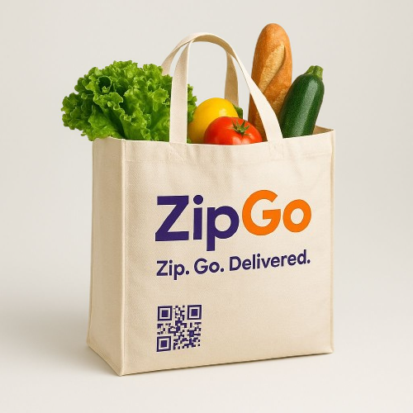
Launching ZIPGO IN KAKINADA: Revolutionizing Quick Commerce with Zepto

Slide 2
The Quick Commerce Revolution: Why Now?
Unprecedented Growth
Booming Market
Kakinada's Potential
The Indian quick commerce market is projected for exponential growth, driven by rising consumer demand for instant delivery services.
Kakinada, a rapidly growing urban hub, is primed for disruption with efficient, reliable local delivery services.
Zepto delivers groceries in just 10 minutes across 50+ Indian cities, handling up to 1.5 million orders daily (2025 data), showcasing immense market potential.

Slide 3
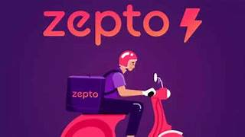
Meet Zepto: India’s Fastest Growing Quick Commerce Startup
Founded: 2021 by Aadit Palicha & Kaivalya Vohra
Unicorn Status: Achieved within 2 years, valued at $5 billion (Dec 2024)
Head quarters : Bengaluru, Karnataka, India
Industry : Quick – commerce
services : Online Grocer
Innovation: Pioneered the "dark store" micro-warehouse model for 10-minute deliveries of 25,000+ products
Funding & Future: Raised $350 million in domestic funding, planning IPO in FY26, with a strong focus on sustainable growth and profitability.

Slide 4



Zipgo + Zepto: A Powerful Collaboration
Leveraging Expertise
Unmatched Service
Democratizing Logistics
Zipgo benefits from Zepto’s proven technology, logistics, and supply chain efficiency for a robust Kakinada launch.
Combining Zipgo’s local market insights with Zepto’s rapid delivery infrastructure ensures unparalleled speed and quality.
This partnership aims to make quick commerce accessible for Kakinada consumers and local brands, fostering growth.

Slide 5
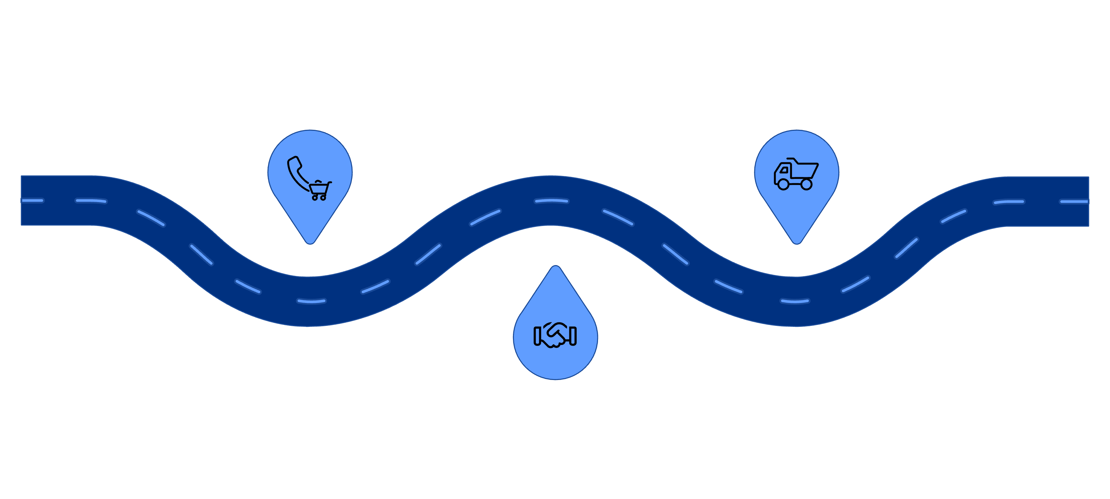



Zipgo’s Vision for Kakinada
Redefining Convenience
Empowering Local Fleets
Seamless rides, easy bookings
Training, tech and fair pay
Supporting Local Businesses
Partner with shops and vendors
Zipgo is committed to transforming daily life in Kakinada by delivering unparalleled convenience while strengthening the local economy through strategic partnerships and job creation.

Slide 6
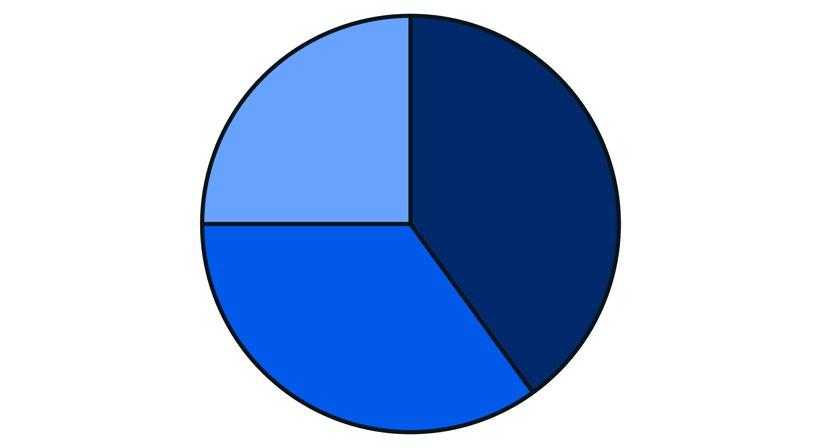
Market Opportunity in Kakinada
Demand For Instant Delivery25%
Urban Population Growth 40%
Smartphone penetration35%%
Kakinada's dynamic growth, combined with increasing tech adoption, creates a fertile ground for Zipgo's instant delivery services. We anticipate capturing a significant market share early on.

Slide 7






How Zipgo Works: Seamless Customer Experience
Optimized Dark Stores
Strategically located micro-warehouses ensure high inventory availability and lightning-fast dispatch.
Intuitive App Interface
Powered by Zepto’s AI-driven order management and real-time tracking for effortless ordering.
Flexible Delivery Options
Choose from 10-minute express, 30-minute standard, or same-day delivery to suit your needs.
From order to doorstep, Zipgo promises a smooth, efficient, and transparent experience, designed for modern urban living.

Slide 8

Overcoming Challenges with Innovation
Zipgo addresses common quick commerce hurdles through smart, tech-driven solutions, ensuring reliable and high-quality service.
Logistical Hurdles: Solved with tech-enabled dark stores and optimized delivery routes.
Product Freshness: Guaranteed through advanced inventory management and cold chain protocols.
Customer Trust: Built with transparent pricing, no hidden fees, and consistently reliable service.

Slide 9
Growth & Impact: What Success Looks Like
100K+
300%+
Local Economy Boost
Monthly Orders
Projected Revenue Growth
Positive Social Impact
Targeting 100,000+ monthly orders in Kakinada by the end of year one.
Aligned with Zepto’s rapid expansion model, anticipating significant financial scaling.
Job creation, support for local kiranas, and enhanced consumer lifestyle for Kakinada residents.

Slide 10
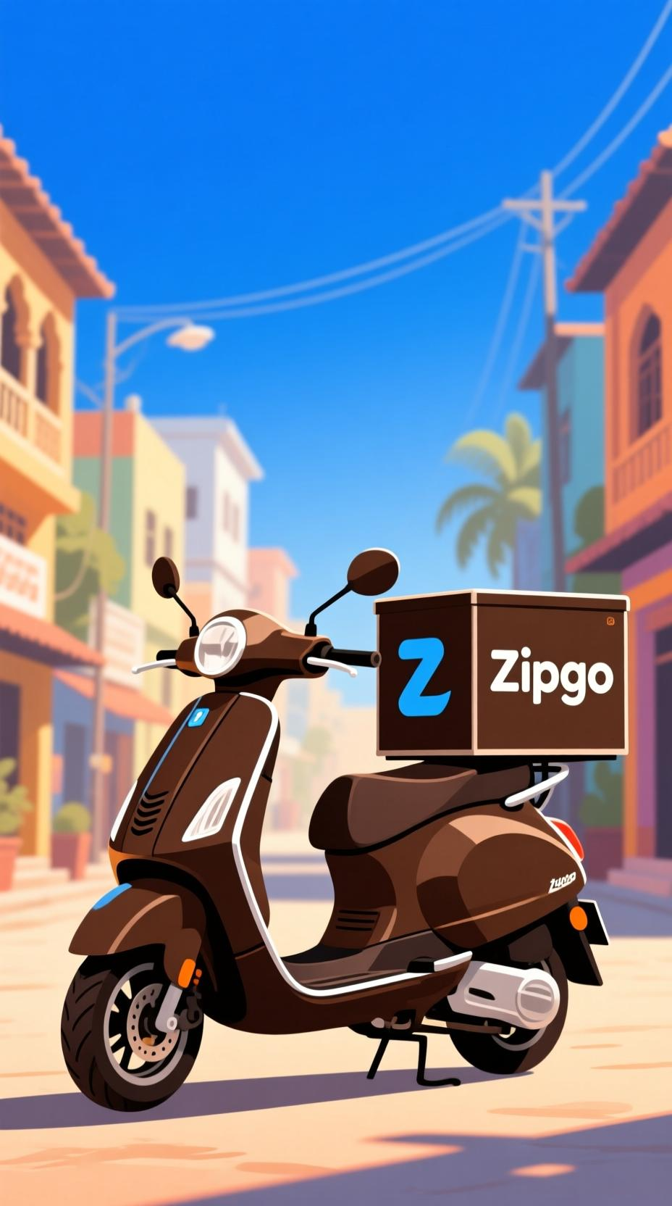
Join Us on This Journey
Zipgo is more than a delivery service—it’s Kakinada’s new way to shop: smart, fast, and local.
Together with Zepto, we are setting a new standard for quick commerce in the city.
"Let’s build the future of instant delivery—one order at a time."

Slide 11
